Slide 1
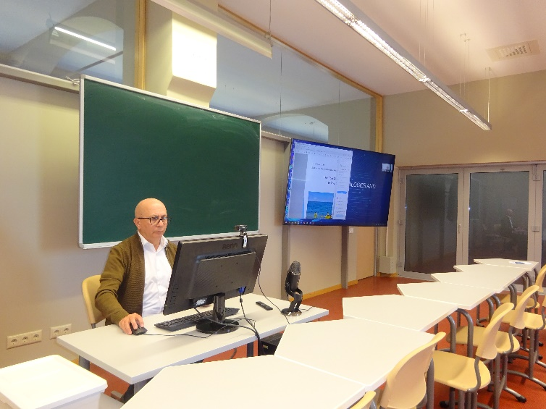
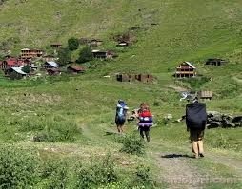
Ermile Meskhia
Batumi Art State University, Georgia
The Role Of Adjara Toirist Routes
In The Cultural Tourism

